Slide 1
Introduction to Joining Data
(view in slide show mode)
Intel Confidential
Notes:
1

Slide 2
This presentation provides an introduction to joining data in SQLPathFinder. SQLPathFinder lets you combine data from multiple data sources into a single output. Data sources can include data from Oracle databases, SQL Server databases, Teradata databases, text files and more.

Slide 3
Agenda
Introduction to Joining & Interleaving Data
Interleaving Concepts
Joining Concepts
Joining Data Tips

Slide 4
Joining and Interleaving Data
Data from multiple data sources can be combined through Joining or Interleaving.
Table 1
Table 2
1
2
3
5
4
Interleaving Data
Joining Data
1
1
1
2
1
2
3
2
4
5
1
=
1
2
Notes:
4/3/97
40
Components Training

Slide 5
Joining and Interleaving Data
Table 1
Table 2
1
2
3
5
4
Interleaving Data
Joining Data
1
1
1
2
1
2
3
2
4
5
1
=
1
Interleaving lets you stack data from multiple sources on top of each other in a particular sort order.
2
Notes:
4/3/97
40
Components Training

Slide 6
Joining and Interleaving Data
Table 2
Table 1
1
3
4
2
5
Interleaving Data
In this example, the green rows represent data from Table 1 and the yellow rows represent data from Table 2. Data from the two tables are interleaved and sorted, with common columns from the two sources being placed underneath each other.
In this example, the green rows represent rows from Table 1 and the yellow rows represent rows from Table 2. Data from the two tables is then interleaved and sorted, with common columns from the two sources being placed underneath each other.
1
2
3
4
5
Notes:
4/3/97
40
Components Training

Slide 7
Joining and Interleaving Data
Table 1
Table 2
1
3
4
2
5
Joining Data
In the case of Joining, data is merged side by side and matched by some common column, such as by a lot number and/or a wafer number, or by a range criteria such as if the date in one source is closest to a date in a second source.
 |  | 1
 |  | 1
 |  | 2
1
2
 |  | 1
 |  | 1
 |  | 2
=
Notes:
4/3/97
40
Components Training

Slide 8
Agenda
Introduction to Joining & Interleaving Data
Interleaving Concepts
Joining Concepts
Joining Data Tips

Slide 9
Interleaving Concepts
PM Data Source 1 SPC Data Source 2
Entity Date CKList Entity Mon Set Chart Val Date
PLM101 1-Jan Clean PLM101 MS 1 2-Jan
PLM101 3-Jan Clean
Interleave & order by columns Entity & Date. Columns with the same header in different data sources are placed underneath each other
Entity Date CKList Mon Set Chart Val
PLM101 1-Jan Clean
PLM101 2-Jan MS 1
PLM101 3-Jan Clean

Slide 10
Interleaving Concepts
PM Data Source 1 SPC Data Source 2
Entity Date CKList Entity Mon Set Chart Val Date
PLM101 1-Jan Clean PLM101 MS 1 2-Jan
PLM101 3-Jan Clean
Interleaving can be used, for example, to overlay different signals by a common time axis for trending. E.g., you might want to plot an SPC parameter value collected at different times on an entity, and overlay that data with the time a certain PM checklist was done. Here, the date a checklist was started is extracted as well as the time an SPC measurement was made on the same entity.

Slide 11
Interleaving Concepts
PM Data Source 1 SPC Data Source 2
Entity Date CKList Entity Mon Set Chart Val Date
PLM101 1-Jan Clean PLM101 MS 1 2-Jan
PLM101 3-Jan Clean
Interleave & order by columns Entity & Date
Entity Date CKList Mon Set Chart Val
PLM101 1-Jan Clean
PLM101 2-Jan MS 1
PLM101 3-Jan Clean
Data is interleaved. As columns Entity & Date have the same headers in both sources, they are stacked on top of each other. Otherwise columns are staggered.

Slide 12
Agenda
Introduction to Joining & Interleaving Data
Interleaving Concepts
Joining Concepts
Joining Data Tips

Slide 13
HOME_PHONE
WORK_PHONE
LAST_
NAME
FIRST_
NAME
HOME
PHONE
LAST_
NAME
LAST_
NAME
FIRST_
NAME
MAIL_
STOP
ADDRESS
LAST_
NAME
WORK
PHONE
CLARKE
AMELIA
123 PEACE
AVENUE
123-4567
CLARKE
RICHARD
C10-87
234-5678
CLARKE
RICHARD
456 WORLD
CENTER...
995-1995
CLARKE
VAHID
901-2345
C10-87
SEARS
THOMAS
789 KINGS
STREET
555-1234
MAY
AMELIA
C2-68
225-1959
Very often you need to join rows from multiple tables to produce a report. Assume you had two tables, one called Home_Phone storing home address information and the other Work_Phone storing Work phone information.
Notes:
4/3/97
42
Components Training

Slide 14
HOME_PHONE
WORK_PHONE
LAST_
NAME
FIRST_
NAME
HOME
PHONE
LAST_
NAME
LAST_
NAME
FIRST_
NAME
MAIL_
STOP
ADDRESS
LAST_
NAME
WORK
PHONE
CLARKE
AMELIA
123 PEACE
AVENUE
123-4567
CLARKE
RICHARD
C10-87
234-5678
CLARKE
RICHARD
456 WORLD
CENTER...
995-1995
CLARKE
VAHID
901-2345
C10-87
SEARS
THOMAS
789 KINGS
STREET
555-1234
MAY
AMELIA
C2-68
225-1959
HOME_PHONE
WORK_PHONE
LAST_NAME
FIRST_NAME
ADDRESS
PHONE
LAST_NAME
FIRST_NAME
MAIL_STOP
PHONE
We can represent the tables by just their columns as shown here.
Notes:
4/3/97
42
Components Training

Slide 15
HOME_PHONE
WORK_PHONE
LAST_
NAME
FIRST_
NAME
HOME
PHONE
LAST_
NAME
LAST_
NAME
FIRST_
NAME
MAIL_
STOP
ADDRESS
LAST_
NAME
WORK
PHONE
CLARKE
AMELIA
123 PEACE
AVENUE
123-4567
CLARKE
RICHARD
C10-87
234-5678
CLARKE
RICHARD
456 WORLD
CENTER...
995-1995
CLARKE
VAHID
901-2345
C10-87
SEARS
THOMAS
789 KINGS
STREET
555-1234
MAY
AMELIA
C2-68
225-1959
HOME_PHONE
WORK_PHONE
LAST_NAME
FIRST_NAME
ADDRESS
PHONE
LAST_NAME
FIRST_NAME
MAIL_STOP
PHONE
Let’s say we wanted to produce a report showing both the home phone number and the work phone number of a person. Our job is to now specify the correct columns for combining the two tables.
Notes:
4/3/97
42
Components Training

Slide 16
HOME_PHONE
WORK_PHONE
LAST_
NAME
FIRST_
NAME
HOME
PHONE
LAST_
NAME
LAST_
NAME
FIRST_
NAME
MAIL_
STOP
ADDRESS
LAST_
NAME
WORK
PHONE
CLARKE
AMELIA
123 PEACE
AVENUE
123-4567
CLARKE
RICHARD
C10-87
234-5678
CLARKE
RICHARD
456 WORLD
CENTER...
995-1995
CLARKE
VAHID
901-2345
C10-87
SEARS
THOMAS
789 KINGS
STREET
555-1234
MAY
AMELIA
C2-68
225-1959
HOME_PHONE
WORK_PHONE
LAST_NAME
FIRST_NAME
ADDRESS
PHONE
LAST_NAME
FIRST_NAME
MAIL_STOP
PHONE
Say we just join on column LAST_NAME
Notes:
4/3/97
42
Components Training

Slide 17
HOME_PHONE
WORK_PHONE
LAST_
NAME
FIRST_
NAME
HOME
PHONE
LAST_
NAME
LAST_
NAME
FIRST_
NAME
MAIL_
STOP
ADDRESS
LAST_
NAME
WORK
PHONE
CLARKE
AMELIA
123 PEACE
AVENUE
123-4567
CLARKE
RICHARD
C10-87
234-5678
CLARKE
RICHARD
456 WORLD
CENTER...
995-1995
CLARKE
VAHID
901-2345
C10-87
SEARS
THOMAS
789 KINGS
STREET
555-1234
MAY
AMELIA
C2-68
225-1959
HOME_PHONE
WORK_PHONE
LAST_NAME
FIRST_NAME
ADDRESS
PHONE
LAST_NAME
FIRST_NAME
MAIL_STOP
PHONE
LAST NAME | FIRST NAME | HOME PHONE | MAIL STOP | WORK PHONE
CLARKE | AMELIA | 123-4567 | C10-87 | 234-5678
CLARKE | AMELIA | 123-4567 | C10-87 | 901-2345
CLARKE | RICHARD | 995-1995 | C10-87 | 234-5678
CLARKE | RICHARD | 995-1995 | C10-87 | 901-2345
Join to Richard Clarke
Join to Vahid Clarke
Join to Richard Clarke
Join to Vahid Clarke
Notes:
17
4/3/97
42
Components Training

Slide 18
HOME_PHONE
WORK_PHONE
LAST_
NAME
FIRST_
NAME
HOME
PHONE
LAST_
NAME
LAST_
NAME
FIRST_
NAME
MAIL_
STOP
ADDRESS
LAST_
NAME
WORK
PHONE
CLARKE
AMELIA
123 PEACE
AVENUE
123-4567
CLARKE
RICHARD
C10-87
234-5678
CLARKE
RICHARD
456 WORLD
CENTER...
995-1995
CLARKE
VAHID
901-2345
C10-87
SEARS
THOMAS
789 KINGS
STREET
555-1234
MAY
AMELIA
C2-68
225-1959
HOME_PHONE
WORK_PHONE
If we just join on column LAST_NAME, we would get a match of the four rows as shown below. This result would not be correct as, for example, Amelia Clarke in table Home_Phone would match with Richard Clarke in table Work_Phone since they both have the same last name.
LAST_NAME
FIRST_NAME
ADDRESS
PHONE
LAST_NAME
FIRST_NAME
MAIL_STOP
PHONE
LAST NAME | FIRST NAME | HOME PHONE | MAIL STOP | WORK PHONE
CLARKE | AMELIA | 123-4567 | C10-87 | 234-5678
CLARKE | AMELIA | 123-4567 | C10-87 | 901-2345
CLARKE | RICHARD | 995-1995 | C10-87 | 234-5678
CLARKE | RICHARD | 995-1995 | C10-87 | 901-2345
Join to Richard Clarke
Join to Vahid Clarke
Join to Richard Clarke
Join to Vahid Clarke
Notes:
18
4/3/97
42
Components Training

Slide 19
HOME_PHONE
WORK_PHONE
LAST_
NAME
FIRST_
NAME
HOME
PHONE
LAST_
NAME
FIRST_
NAME
FIRST_
NAME
LAST_
NAME
FIRST_
NAME
MAIL_
STOP
ADDRESS
LAST_
NAME
WORK
PHONE
CLARKE
AMELIA
123 PEACE
AVENUE
123-4567
CLARKE
RICHARD
C10-87
234-5678
CLARKE
RICHARD
456 WORLD
CENTER...
995-1995
CLARKE
VAHID
901-2345
C10-87
SEARS
THOMAS
789 KINGS
STREET
555-1234
MAY
AMELIA
C2-68
225-1959
HOME_PHONE
WORK_PHONE
(Left) Outer Join
LAST_NAME
FIRST_NAME
ADDRESS
PHONE
LAST_NAME
FIRST_NAME
MAIL_STOP
PHONE
If instead we join by columns LAST_NAME and FIRST_NAME…
Notes:
19
4/3/97
42
Components Training

Slide 20
HOME_PHONE
WORK_PHONE
LAST_
NAME
FIRST_
NAME
HOME
PHONE
LAST_
NAME
FIRST_
NAME
FIRST_
NAME
LAST_
NAME
FIRST_
NAME
MAIL_
STOP
ADDRESS
LAST_
NAME
WORK
PHONE
CLARKE
AMELIA
123 PEACE
AVENUE
123-4567
CLARKE
RICHARD
C10-87
234-5678
CLARKE
RICHARD
456 WORLD
CENTER...
995-1995
CLARKE
VAHID
901-2345
C10-87
SEARS
THOMAS
789 KINGS
STREET
555-1234
MAY
AMELIA
C2-68
225-1959
HOME_PHONE
WORK_PHONE
(Left) Outer Join
LAST_NAME
FIRST_NAME
ADDRESS
PHONE
LAST_NAME
FIRST_NAME
MAIL_STOP
PHONE
(LEFT) OUTER JOIN RESULTS
…then our results just show a match on Richard Clarke
LAST NAME | FIRST NAME | HOME PHONE | MAIL STOP | WORK PHONE
CLARKE | AMELIA | 123-4567
CLARKE | RICHARD | 995-1995 | C10-87 | 234-5678
SEARS | THOMAS | 555-1234
Notes:
20
4/3/97
42
Components Training

Slide 21
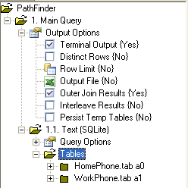
HOME_PHONE
WORK_PHONE
LAST_
NAME
FIRST_
NAME
HOME
PHONE
LAST_
NAME
FIRST_
NAME
FIRST_
NAME
LAST_
NAME
FIRST_
NAME
MAIL_
STOP
ADDRESS
LAST_
NAME
WORK
PHONE
CLARKE
AMELIA
123 PEACE
AVENUE
123-4567
CLARKE
RICHARD
C10-87
234-5678
CLARKE
RICHARD
456 WORLD
CENTER...
995-1995
CLARKE
VAHID
901-2345
C10-87
SEARS
THOMAS
789 KINGS
STREET
555-1234
MAY
AMELIA
C2-68
225-1959
HOME_PHONE
WORK_PHONE
The default join in SQLPathFinder is called an Outer Join. I.e., the first table in the join is the driving table and all rows from that table that match the filter criteria are returned whether or not there is a match in the other tables.
(Left) Outer Join
LAST_NAME
FIRST_NAME
ADDRESS
PHONE
LAST_NAME
FIRST_NAME
MAIL_STOP
PHONE
(LEFT) OUTER JOIN RESULTS
LAST NAME | FIRST NAME | HOME PHONE | MAIL STOP | WORK PHONE
CLARKE | AMELIA | 123-4567
CLARKE | RICHARD | 995-1995 | C10-87 | 234-5678
SEARS | THOMAS | 555-1234
Notes:
21
4/3/97
42
Components Training

Slide 22
HOME_PHONE
WORK_PHONE
LAST_
NAME
FIRST_
NAME
HOME
PHONE
LAST_
NAME
FIRST_
NAME
FIRST_
NAME
LAST_
NAME
FIRST_
NAME
MAIL_
STOP
ADDRESS
LAST_
NAME
WORK
PHONE
CLARKE
AMELIA
123 PEACE
AVENUE
123-4567
CLARKE
RICHARD
C10-87
234-5678
CLARKE
RICHARD
456 WORLD
CENTER...
995-1995
CLARKE
VAHID
901-2345
C10-87
SEARS
THOMAS
789 KINGS
STREET
555-1234
MAY
AMELIA
C2-68
225-1959
HOME_PHONE
WORK_PHONE
If there is no join column match in the other tables, the associated column cells in the other tables are shown empty. Hence no work phone information is shown for Amelia Clarke nor Thomas Sears.
(Left) Outer Join
LAST_NAME
FIRST_NAME
ADDRESS
PHONE
LAST_NAME
FIRST_NAME
MAIL_STOP
PHONE
(LEFT) OUTER JOIN RESULTS
LAST NAME | FIRST NAME | HOME PHONE | MAIL STOP | WORK PHONE
CLARKE | AMELIA | 123-4567
CLARKE | RICHARD | 995-1995 | C10-87 | 234-5678
SEARS | THOMAS | 555-1234
NULL
Notes:
22
4/3/97
42
Components Training

Slide 23
HOME_PHONE
WORK_PHONE
LAST_
NAME
FIRST_
NAME
HOME
PHONE
LAST_
NAME
LAST_
NAME
FIRST_
NAME
MAIL_
STOP
ADDRESS
LAST_
NAME
WORK
PHONE
CLARKE
AMELIA
123 PEACE
AVENUE
123-4567
CLARKE
RICHARD
C10-87
234-5678
CLARKE
RICHARD
456 WORLD
CENTER...
995-1995
CLARKE
VAHID
901-2345
C10-87
SEARS
THOMAS
789 KINGS
STREET
555-1234
MAY
AMELIA
C2-68
225-1959
HOME_PHONE
Checking the Outer Join Results node under the SQLPathFinder Output Options tree ensures that an outer join will be done.
WORK_PHONE
(Left) Outer Join
LAST_NAME
FIRST_NAME
ADDRESS
PHONE
LAST_NAME
FIRST_NAME
MAIL_STOP
PHONE
(LEFT) OUTER JOIN RESULTS
LAST NAME | FIRST NAME | HOME PHONE | MAIL STOP | WORK PHONE
CLARKE | AMELIA | 123-4567
CLARKE | RICHARD | 995-1995 | C10-87 | 234-5678
SEARS | THOMAS | 555-1234
NULL
Notes:
23
4/3/97
42
Components Training

Slide 24
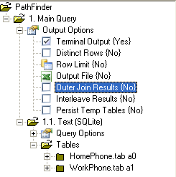
HOME_PHONE
WORK_PHONE
LAST_
NAME
FIRST_
NAME
HOME
PHONE
FIRST_
NAME
FIRST_
NAME
ADDRESS
LAST_
NAME
FIRST_
NAME
MAIL_
STOP
WORK
PHONE
CLARKE
AMELIA
123 PEACE
AVENUE
123-4567
CLARKE
RICHARD
C10-87
234-5678
CLARKE
RICHARD
456 WORLD
CENTER...
995-1995
CLARKE
VAHID
901-2345
C10-87
SEARS
THOMAS
789 KINGS
STREET
555-1234
MAY
AMELIA
C2-68
225-1959
HOME_PHONE
WORK_PHONE
If we uncheck the Outer Join Results node under the Output Options tree, then an Inner Join is done and only rows that match on the join condition in all tables are returned. Hence, only data for Richard Clarke is returned.
(Left) Outer Join
LAST_NAME
FIRST_NAME
ADDRESS
PHONE
LAST_NAME
FIRST_NAME
MAIL_STOP
PHONE
INNER JOIN RESULTS
LAST NAME | FIRST NAME | HOME PHONE | MAIL STOP | WORK PHONE
CLARKE | RICHARD | 995-1995 | C10-87 | 234-5678
Notes:
24
4/3/97
42
Components Training

Slide 25
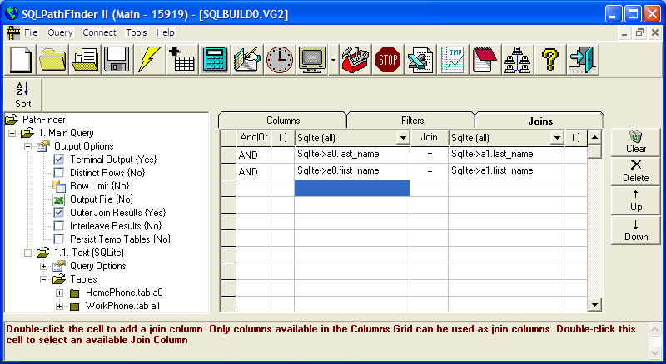
This slide shows how the Join we just described would be configured in SQLPathFinder.

Slide 26
Joining Concepts
Click Left Mouse
button to advance
First we pull Sort wafer data perhaps by a date range
Joins in SQLPathFinder are actually done in steps behind the scenes. For example, let's say we wanted to combine data from a Sort wafer data source with data from a YAS wafer level data source. As YAS does not store the full 12 digit wafer scribe we’ll do the join by the seven digit lot numbers and the three digit wafer IDs so we match on any split lots.
Data for a
Date range
Layer
Sort Wafer Data
YAS Data
Lot Like Temp
Lot7
Temp Table
Temp Table
Sort Results
YAS Results
Next we pull YAS data for a layer & we feed the 7 digit lot numbers from Sort to the YAS query using the Like Temp filter operator. The full Sort lot number will be like the list of 7 digit lots from Sort. This allows us to pull child lots. If we used the In Temp search operator then YAS lot numbers would need to be exactly equal to the Sort lot numbers.
Lot, Lot7, Wafer,IB1
L12345678,L1234567,111,100
L1234567A,L1234567,222,200
N12345678,N1234567,222,300
Lot, Lot7, Wafer,NCDD1
L12345678,L1234567,111,.01
L1234567A,L1234567,.222,02
N12345678,N1234567,222,.03
Join
lot7 + wafer
…and output results to a Temporary Table.
Finally, the temp tables are joined by the 7 digit lot numbers & by the 3 digit wafer IDs
So, the YAS results are output to another temporary table.
Joined Results
Lot, Lot7, Wafer,IB1,NCDD1
L12345678,L1234567,111,100,.01
L1234567A,L1234567,222,200,.02
N12345678,N1234567,222,300,.03
Notes:
4/3/97
45
Components Training

Slide 27
Agenda
Introduction to Joining & Interleaving Data
Interleaving Concepts
Joining Concepts
Joining Data Tips

Slide 28
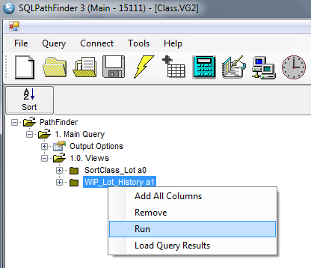
Joining Data Tips
Because join queries can be complex, SQLPathFinder lets you run the query either in stages or in its entirety. Running a query in stages can help you see the intermediate outputs to determine what is going on at a particular step of the join.

Slide 29
Joining Data Tips
Run a Query Segment
To run a particular query segment, right-click over the view name and choose Run from the drop down menu.

Slide 30
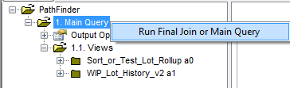
Joining Data Tips
Run Join
To run the join portion of the query, right-click over the Main Query node, and choose option Run Final Join or Main Query from the drop-down menu

Slide 31
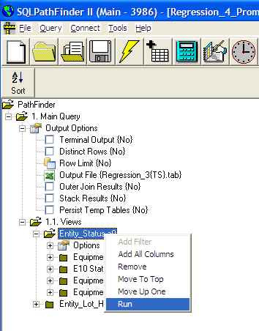
Joining Data Tips
Clicking the lightning bolt icon on the SQLPathFinder toolbar runs the entire query.
Run the entire Query

Slide 32
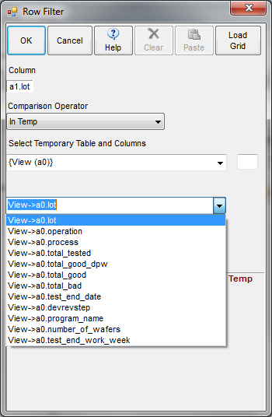
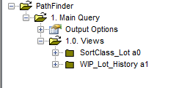
Joining Data Tips
Temp Tables allow columns in “earlier” sub-queries to be referenced in later sub-queries. E.g., here data for SortClass_Lot is written to a Temp table, and view WIP_Lot_History can reference these temp table columns using filters In Temp or Like Temp to improve its query performance.
Another important tip when joining is to leverage Temp tables created by intermediate sub-queries to feed later sub-queries.

Slide 33
Final Quiz!
Following are a few questions on joining.
Click the Initialize button to initialize the Quiz and click Next to start the Quiz
Initialize
Quiz
Intel Confidential
Notes:
33

Slide 34
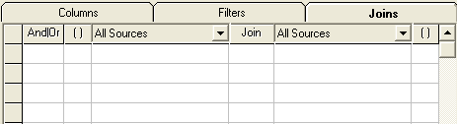
Quiz: Use the Combo Boxes to Complete the Join for the following Sort & YAS Data Sources?
SortClass_Wafer_Test_Sessions a0
YAS a1
Sort_ Lot | Sort_ Lot7 | Txn_ Date | IB1 | Wafer_ID
F9305100 | F930510 | 20-Aug | 788 | 274
F9304990 | F930499 | 21-Aug | 98 | 523
F9315330 | F931533 | 22-Aug | 571 | 274
Lot | Lot7 | Layer | Small_ Particle | Wafer_ID
F930510A | F930510 | M7BS | 12 | 274
F9304990 | F930499 | M7BS | 0 | 523
F931533B | F931533 | M7BS | 10 | 274
And
Check
Answer
Reset

Slide 35


Quiz: Use the Combo Boxes to Complete the Join for the following
WIP Data Sources?
WIP_Lot_Status a0
ATD_BOM_Status a1
Check
Answer
Reset

Slide 36
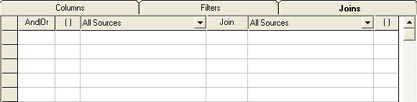
Quiz: Use the Combo Boxes to Complete the Join so That the Lot Date Occurs Between the SPC Monitor Date & the Next Monitor date
Etch Etch Etch Etch
Rate Rate Lot1 Lot2 Rate Rate
time
16-Aug 19-Aug 20-Aug 21-Aug 22-Aug 25-Aug
SPC_Chart_Or_Raw a0
Entity_Lot_Wafer_History a1
SPC_ Entity | Meas_Set | SPC_ Parent_Entity | SPC_ Chbr | SPC_ Date | Next_ SPC_ Date | Chart_ Value
OX1_PC1 | ER | OX1 | PC1 | 19-Aug | 22-Aug | 3950
OX1_PC1 | ER | OX1 | PC1 | 22-Aug | 25-Aug | 3920
Entity | Chbr | TDate | Lot
OX1 | PC1 | 20-Aug | Lot1
OX1 | PC1 | 21-Aug | Lot2
a0.spc_parent_entity = a1.Entity
Reset
Answer

Slide 37
That concludes the presentation
on Joining Data
Intel Confidential

